Slide 1
Who is Effective at Developing Internet Standards?

Slide 2
Aim
this project will explore what organisations and countries are effective at developing technical standards for the Internet.
Goal:will be to look at the history of the documents eventually published as standards-track RFCs to understand how long they took to develop, who was involved in their development, how the various participants in the process interacted, and whether there were any roadblocks or significant problems in the development of the standards.
Eventual aim: to understand who is effective at developing Internet standards. Is Google better at standards development than Apple? Is Cisco more effective than Huawei? Are China and India, for example, becoming more effective at developing Internet-related standards over time?

Slide 3
Main Research Question
How do organisations contribute to and influence Internet standardisation within the IETF?

Slide 4
Research Question 1
Which organisations participate most actively in Internet standardisation?
Why is it interesting?
谁真正提交Draft、
谁真正参与Working Group。
Which Chinese companies?
Which US companies?
Which universities?
Which governments?

Slide 5
Research Question 2
Which organisations are most successful in converting Internet-Drafts into RFCs?
Security
Routing
Transport
Applications
Maybe Huawei is good at Routing but not good at Security.

Slide 6
Research Question 3
How have organisational participation and effectiveness changed over time?
2000–2004
2005–2009
2010–2014
2015–2019
2020–2025
每个阶段：
Draft
RFC
Success Rate
作者人数
国家变化
组织变化

Slide 7
Research Question 4（Case Study）
How did the 2019 U.S. Entity List change Huawei's participation and collaboration within the IETF?

Slide 8
Methodology
Stage1:
Dataracker - Draft - RFC - Author - Organisation
Stage2:
join Meeting Attendance
哪些组织：真正参加会议。
Stage3:
join Mailing list
Analyse who command draft,push draft ,influence RFC

Slide 9
Sub Question
Which organisations participate the most?
Which organisations are most successful in converting Internet-Drafts into RFCs?
How have organisational participation and success changed over time?
Case Study: Changes in Huawei's Participation and Organisational Effectiveness Before and After the 2019 U.S. Entity List

Slide 10
IETF
IETF is the organisation responsible for Internet standardisation.
It provides Datatracker, historical archives, mailing lists and meeting records.
Intention : understand who proposes topics for Internet standardisation and how effective they are at getting their work accepted.

Slide 11
Draft、RFC
Draft 是一个还在讨论中的标准草案。
例如某人写了一个新协议想法，先提交成：
Internet-Draft
大家在 IETF 邮件列表、会议、GitHub 上讨论、修改
如果这个 Draft 最后被接受、审核、发布，它就会变成：
RFC
RFC 可以理解为正式发布的互联网技术文档。有些 RFC 是真正的标准，有些是信息性文档。

Slide 12
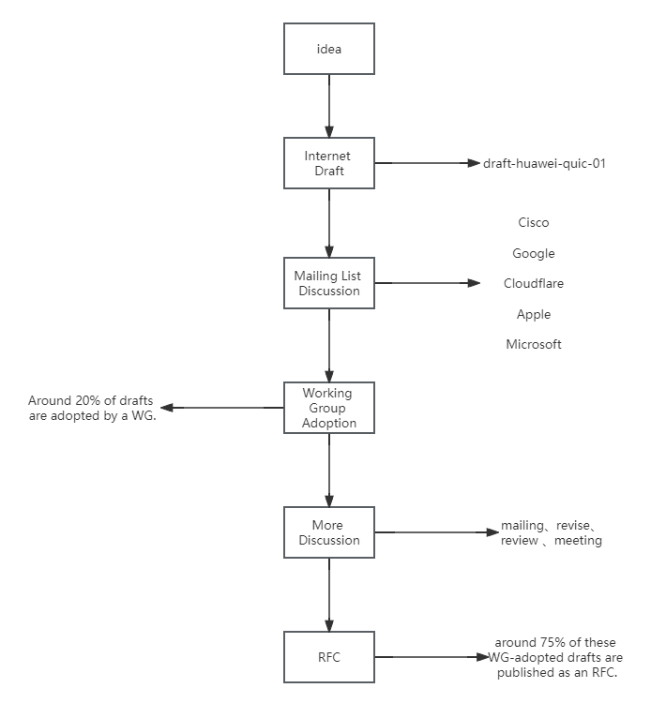
这和 Huawei / Cisco / Google 有什么关系？
Draft 不是凭空出现的，它有作者。
作者通常有公司 affiliation，比如：
Author A — Huawei
Author B — Cisco
Author C — Google
所以如果一个 Draft 最后变成 RFC，你可以说：
这个 RFC 的作者来自 Huawei / Cisco / Google
然后就可以统计：
Huawei 写了多少 Draft？
其中多少变成 RFC？
Cisco 写了多少 Draft？
其中多少变成 RFC？
Google 写了多少 Draft？
其中多少变成 RFC？
这就是你研究 Huawei、Cisco、Google 的原因。

Slide 13
Task
1-4week：阅读文献、理解IETF、写Literature Review、写Requirements
5-10week：Coding+Data Analysis
final 2 weeks:完成Disseration

Slide 14
一、谁参与了标准制定Who participated in standard setting
找出所有Standards Documents（RFC）
谁写的？
作者来自哪个公司
作者来自哪个国家
RFC XXX
Author A ——Cisco ——USA
统计：
2020
Cisco： 30篇
Huawei： 18篇
Google: 12篇

Slide 15
二、谁真正做出了贡献（真正影响RFC的人是谁） Who truly made contributions (who actually influenced the RFCs)
不要只看作者
还要找acknowledgement（感谢名单）
以及mail Archive（邮件讨论）
Github Discussion

Slide 16
三、公司之间如何合作How companies collaborate with each other
可以建立company collaboration network
Cisco——Huawei
Cisco——Google
然后比较2005，2010，2015，2020合作关系变化

Slide 17
四、国家影响力变化Changes in national influence

Slide 18
真正的问题：新公司怎样才能进入IETF
example:Huawei最开始：
没有经验。
后来：
招聘很多美国标准专家。
然后：
再培养中国工程师。
于是：
拥有越来越大的影响力

Slide 19
Social Graph（社交网络图）
Regard each participant as a node.
If a reply b
a—>b
We observe an interaction between two participants when one replies to an email sent by another.
The more people you know, The more success you will be(become RFC)
The more interation someone has -The more influence they have
邮件影响力高的人
↓
更可能写更多 Draft

Slide 20
Betweenness Centrality（中介中心性） 。
这是社会网络分析里非常经典的指标
它衡量的是：
一个人是不是很多人之间的"桥梁"。
Huawei ---- Alice ---- Bob ---- Cisco
|
Google
那么 Alice 的 betweenness centrality 就很高。（连接别人最多）

Slide 21
untimate goal
Focus：只分析“公司/组织的 Draft 是否成功变成 RFC”
Which organisations are more effective at getting their Internet-Drafts published as RFCs?
I would like to start with a focused analysis of organisations’ effectiveness, using document authorship and whether drafts become RFCs. I plan to compare organisations such as Cisco, Google, Microsoft, Huawei, ZTE, Ericsson, and Nokia over time.
我想先从组织层面的有效性分析开始，使用文档作者和 Draft 是否变成 RFC 作为主要数据。我计划比较 Cisco、Google、Microsoft、Huawei、ZTE、Ericsson、Nokia 等组织随时间的变化。

Slide 22
1995
Cisco：20
Google：1
Huawei：0
↓
2025
Cisco：30
Google：45
Huawei：18
再结合：
RFC Success Rate

Slide 23
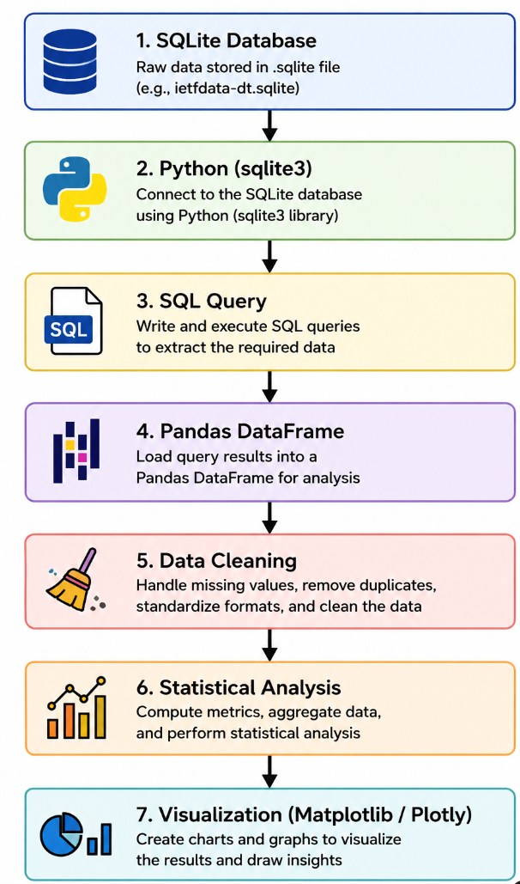
my idea

Slide 24
new idea：
Did the 2019 Entity List change organisational collaboration within the IETF?
Before:
Huawei —— Cisco
Huawei —— Google
Huawei —— Ericsson
now:
Huawei —— Cisco
↓
reduce？
Huawei —— Google
↓
reduce？
Huawei —— Ericsson
↓
stay？

Slide 25
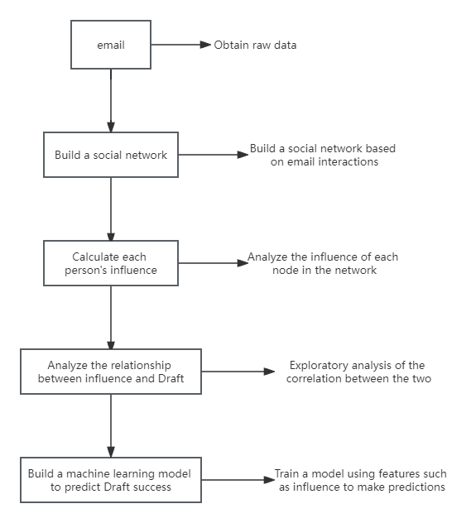
idea in web-we-weave

Slide 26
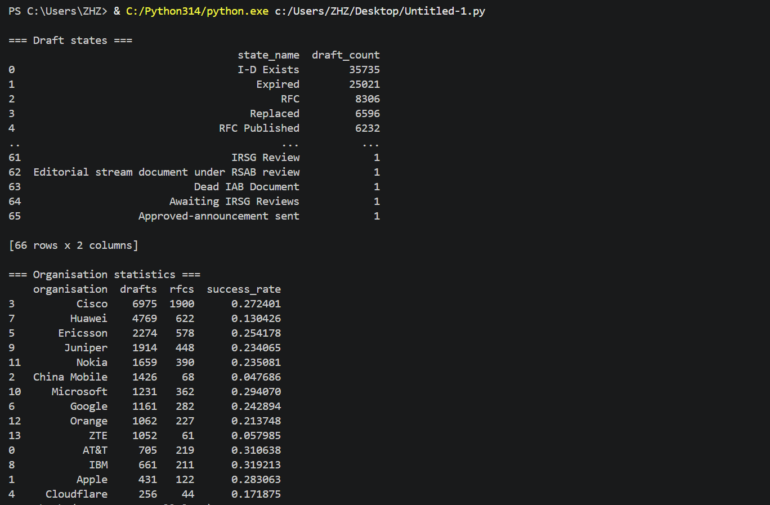
Result

Slide 27
question
Is it reasonable to focus on organisational effectiveness instead of analysing the mailing-list social graph?
Should the dissertation focus primarily on:
Participation
Success Rate
or both?
which question moere important free questuion ,each question dirrt pof the data ,meetiung look at the document the ,looking at the miling list data depend the we used ,think about or you should do analyisising the small mailing more important,slowly and quickly
Would adding a case study (e.g., Huawei after the 2019 Entity List) strengthen the dissertation?

